Slide 1


PANIMALAR ENGINEERING COLLEGE
Department of Computer Science and Engineering
Second Project Review
Cloud based Attendance System For Students/Employees using CNN and LSTM
Domain:
Deep Learning, Cloud computing( Flask )
Team Members:
G Surendar (2017PECCS268)
S Vasanth (2017PECCS275)
VISHNU J (2017PECCS283)

Slide 2
INTRODUCTION
In this online era the management of the attendance can be a great burden on the teachers, faculty members and organisations as it's done by hand.
They also face the problem of proxy attendance, maintaining all hand written document of student attendance .
Even though smart and auto attendance management system like RF id and biometrics are being utilized, authentication is an important issue in this system.
Face recognition is one of the biometric methods to improve this system.
In this project we build a Web Application powered with the help of Amazon EC2 instance.

Slide 3
OBJECTIVE OF THE PROJECT
In this Virtual Era Institute’s and Corporates are moving towards e-learning and e-training facilities where attendance plays an vital role.
Having time constraints as a limit, we have come with an idea of an automated attendance system and head-count during any live session .
The head count will be taken in random duration to prevent flaws and attendance will be verified on change of headcount.
The Main Objective of this project is to reduce the burden that is carried out manually for taking attendance by replacing it with Cloud Based attendance system using Facial Recognition.

Slide 4
Existing System
The concept of attendance system based on face recognition technology is proposed, and the research on face recognition attendance system based on real-time video processing is carried out.
The algorithm used for face recognition technique i.e. For image classification is CNN, face feature extraction by LDA method.
Research data shows that the accuracy of the video face recognition system is about 82%.

Slide 5
Proposed System
In this project we build an Web Application powered by Amazon EC2 Linux instance to display marked Attendance from the SQL Database.
The output from the conference screen is taken as an input for the system.
The input screen is converted to gray scale and feeded to model trained using haarCascade to extract facial data sets and head count.
The extracted facial dataset is passed to an model trained using Convolutional neural network (CNN) having Long short-term memory (LSTM).

Slide 6
Proposed System
The attendance is updated in MySQL Database for backend services like Flask to fetch and propogate in Admin / staff login portal.
This portal alows the instructor to edit and update the attendance entered by the system.
Performance of the system is increased with encouraging results of initial experiments.
The head count will be taken in random duration to prevent flaws and attendance will be verified on change of headcount.

Slide 7
SYSTEM HARDWARE AND SOFTWARE REQUIREMENTS:
MINIMUM HARDWARE REQUIREMENTS:
Processor : core i5/i7/i8
RAM : 4GB
CPU : 2 x 64-bit 2.8GHZ 8.00 GT/s
Disk storage : 500 GB

Slide 8
SOFTWARE REQUIREMENTS:
Cloud Hosting (AWS)
Flask
Python
Front end (Bootstrap, Html, CSS)

Slide 9
SYSTEM DESIGN:

Slide 10
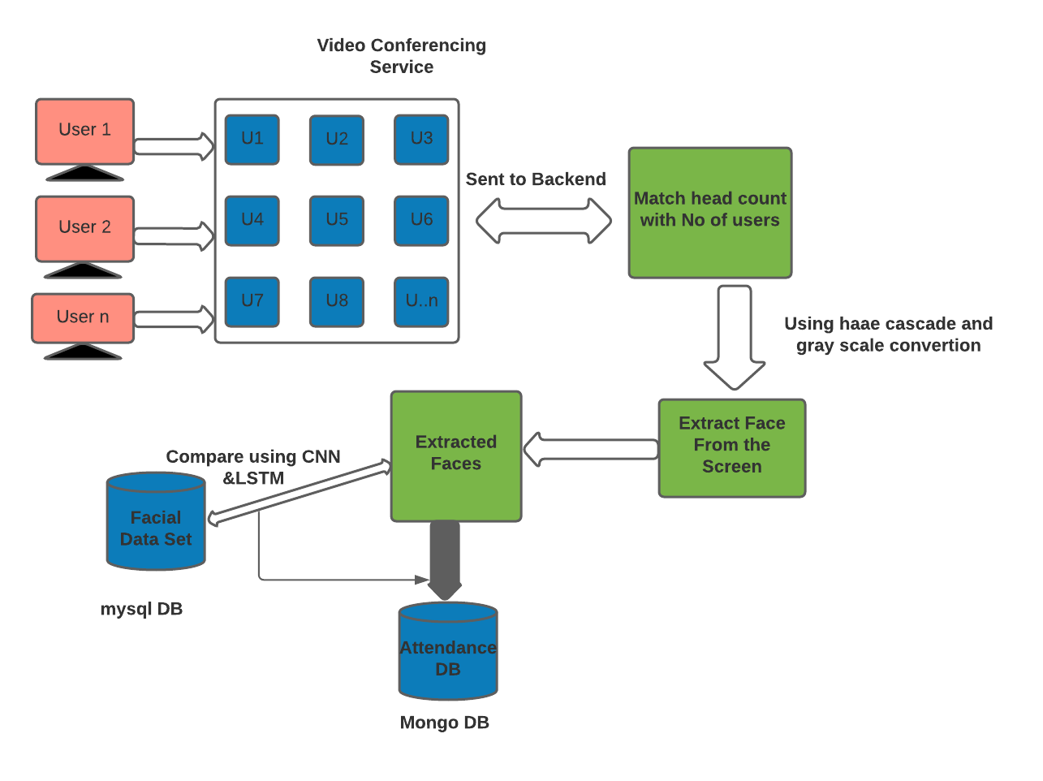
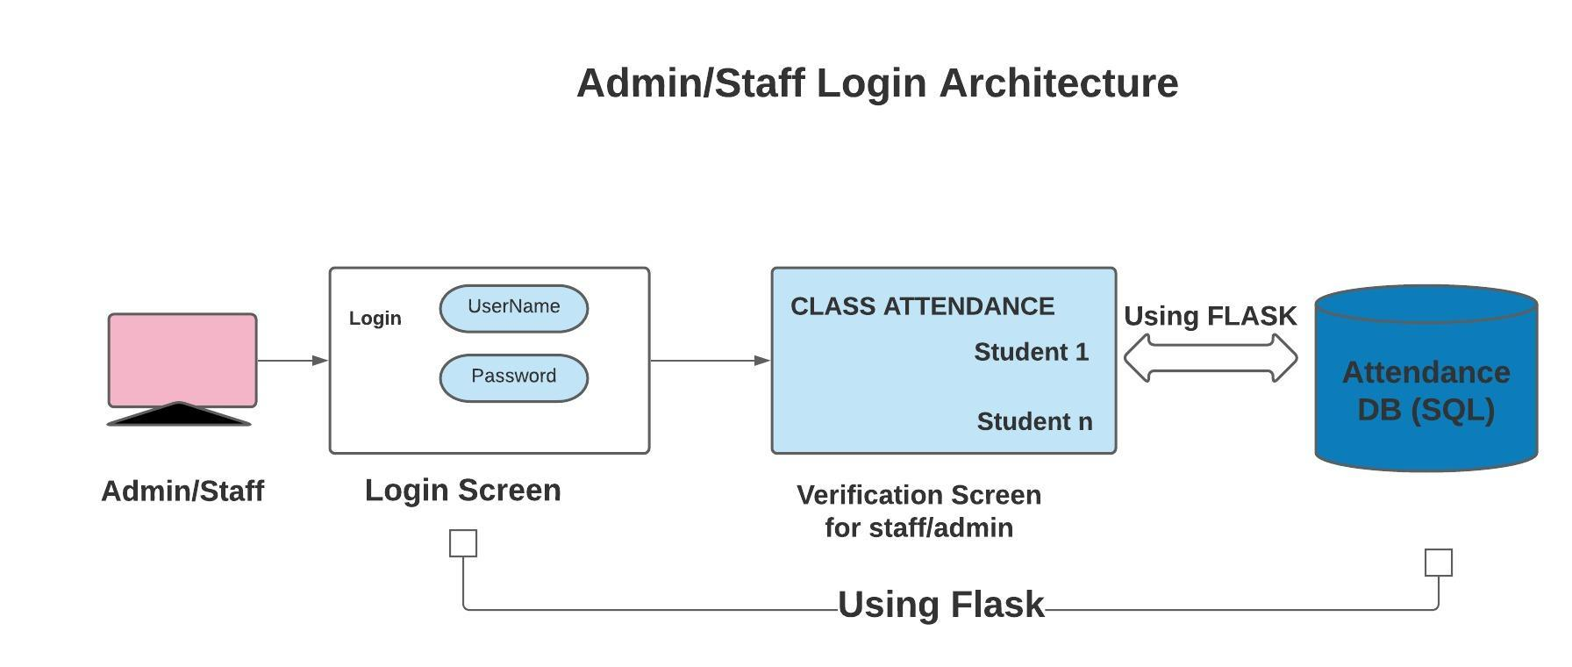
Architecture / Methodology used
BASE ARCHITECTURE

Slide 11
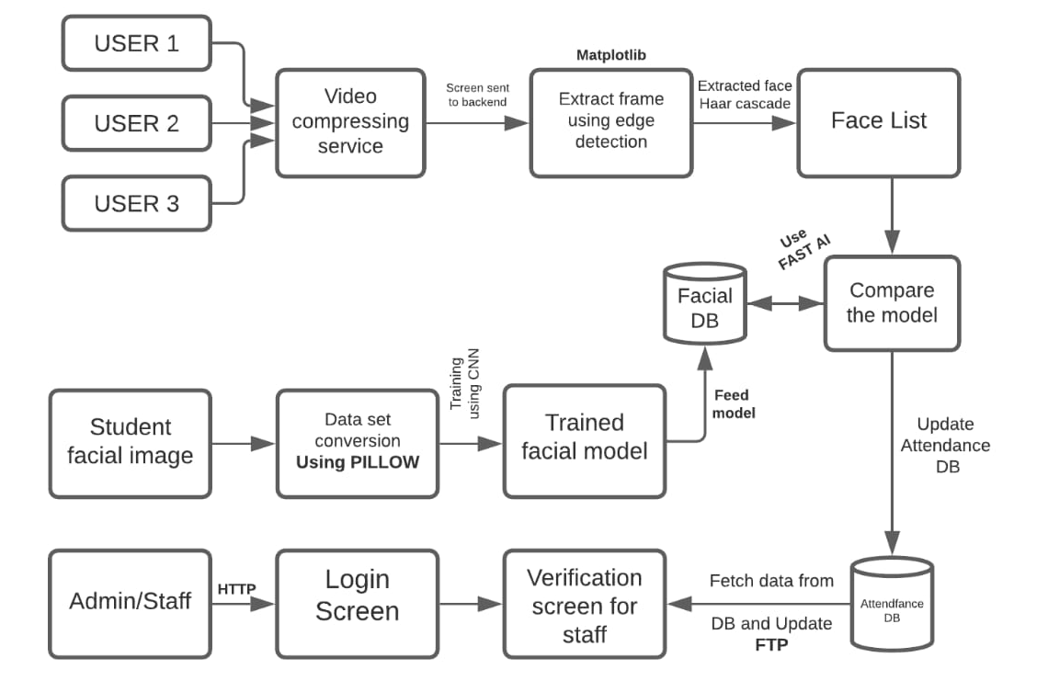
BLOCK DIAGRAM

Slide 12
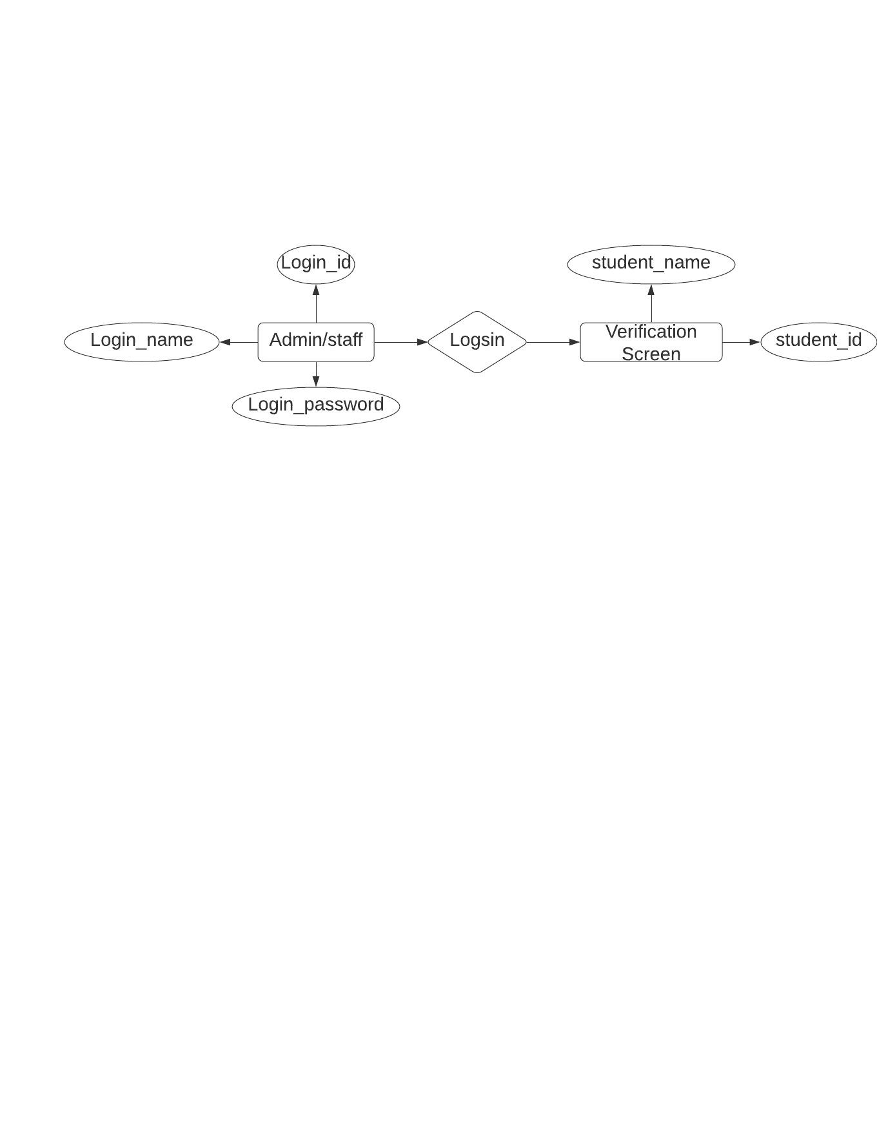
ENTITY -RELATION SHIPS DIAGRAM:
ER Diagram for Admin/staff architecture.

Slide 13
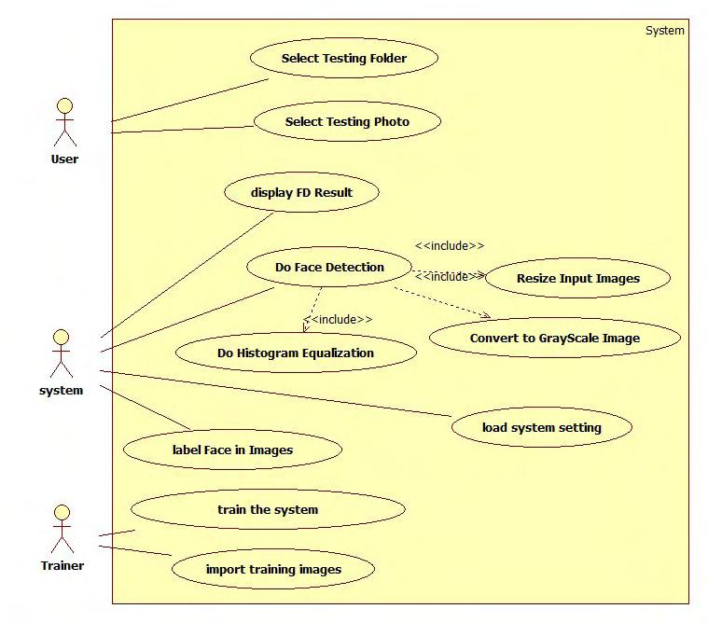
USE CASE DIAGRAM:

Slide 14
Python Libraries that would be need to achieve the task:
1.Numpy
2. Pandas
3. Sci-kit Learn
4. Matplotlib
5. Seaborn
The project workflow can be explained in following steps,
Gathering data
Data cleaning/Data preprocessing
Researching the model that will be best for the type of data
Training the model
Evaluation.

Slide 15
ALGORITHM AND MODEL DESCRIPTION:
5.1 CNN based Training:
A CNN is a Deep Learning algorithm which can take in an input image.
Then itassign importance to various aspects/objects in the image and be able to differentiate one from the other.
The pre-processing required in a ConvNet is much lower as compared to other classification algorithms.
In primitive methods filters are hand-engineered, with enough training, ConvNets have ability to learn these filters.

Slide 16
5.2 Exporting the Model to the Cloud:
The model generated after CNN is transferred to cloud (AZURE) and configuration is done through SSH.
→ Connecting to server:
$ ssh -X <user Name>@<IP address>
$ ssh -X Attendannce@192.178.43.71
→ Pushing the Model to the Cloud:
$ scp <file name> <use Name>@<server ip>:\root\<fileName>
5.3 Using Dlib and Cmake for system compatibility:
Dlib is a modern C++ toolkit containing machine learning algorithms and tools for creating complex software in C++ to solve real world problems.
It is used in both industry and academia in a wide range of domains including robotics, embedded devices and high performance computing environments.
Dlib's open source licensing allows you to use it in any application, free of charge.

Slide 17

5.4 Connecting the cloud using Flask
Flask-SocketIO gives Flask applications access to low latency bi-directional communications between the clients and the server.
The client-side application can use any of the SocketIO official clients libraries in Javascript, C++ and Swift.

Slide 18
TESTING/PERFORMANCE ANALYSIS:
HOST ID | MODULE NAME | INPUT | EXPECTED OUTPUT | ACTUAL OUTPUT | REMARKS
TC01 | Facial Recognition module | Registered faces | Detection of the face with the name of the person. | Pass | Module works as expected.
TC02 | Facial Recognition module | Unregistered faces | Detection of the face with the message as an unknown person. | Pass | The face of the unknown person can be registered in the database to get better results.

Slide 19
LITERATURE SURVEY
TITLE | AUTHOR | YEAR | JOURNAL/ MAGAZINE | METHODOLOGY | INFERENCE
Face Recognition Attendance System Based on Real-Time Video Processing | HAO YANG AND XIAOFENG HAN | 2020 | IEEE ACCESS | DEEP LEARNING | In this paper, the concept of attendance system based on face recognition technology is proposed, and the research on face recognition attendance system based on real-time video processing is carried out using CNN algorithm and the efficiency is about 82%
Automated Attendance Systems Using Face Recognition by K-Means Algorithms | N Palanivel; S Aswinkumar; J Balaji | 2019 | IEEE | MACHINE LEARNING | In this paper, a K-means clustering algorithmic rule is employed to research the facial expression. The biometric features of the face unit are extracted and also the K-mean clustering technique is used to cluster the face features. Then, SVM methodology is employed to classify the features of the image. Finally, a report is generated for interpretation.
Smart Attendance Management System Using Face Recognition | Kaneez Laila Bhatti , Laraib Mughal , Faheem Yar Khuhawar , Sheeraz Ahmed Memon | 2019 | EIA | DEEP LEARNING | In this paper, deep learning techniques to develop this system, The frontend side (client side) which consist of GUI which is based on electron JS and backend side consist of logic and python (server side), an IPC (Inter Personal Communication) bridge is developed to communicate these two stacks. The images capture by the camera is sent to system for further analysis, the input image is then compared with a set of reference images of each of the student and mark their attendance.

Slide 20
Face Recognition based smart attendance system using IOT | Sakshi Patel, Prateek Kumar , Shelesh Garg , Ravi Kumar | 2018 | IJCSE | IOT,OPENCV, SMTP | This project uses a face recognizer library for facial recognition and storing attendance. The absentee’s supervisor or parents are informed through email regarding the absence of their employees or wards respectively. The objective of this project is to innovate existing projects with some added feature like large data storage and fast computing through less hardware cost.
An automated classroom attendance system using video basedface recognition | Anshun Raghuwanshi; Preeti D Swami | 2017 | IEEE | MACHINE LEARNING | This paper proposes and compares the methodologies for an automated attendance system using video-based face recognition. Face recognition is performed and compared on the basis of the accuracy of recognition using Principle Component Analysis (PCA) and Linear Discriminant Analysis (LDA) algorithms.

Slide 21
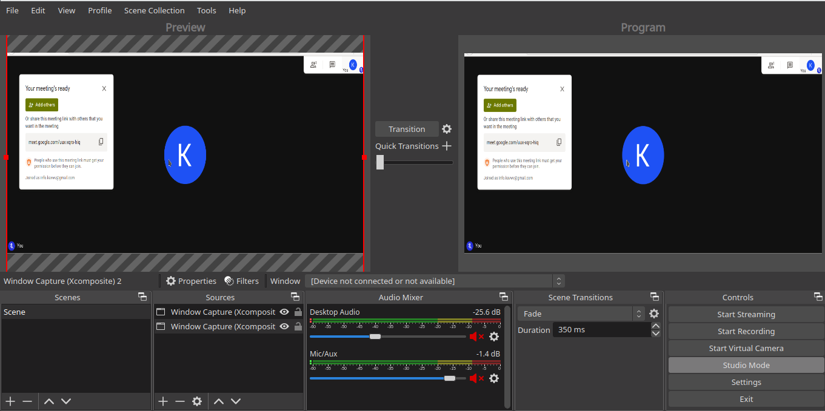
APPENDICES:
SAMPLE SCREENSHOTS:

Slide 22
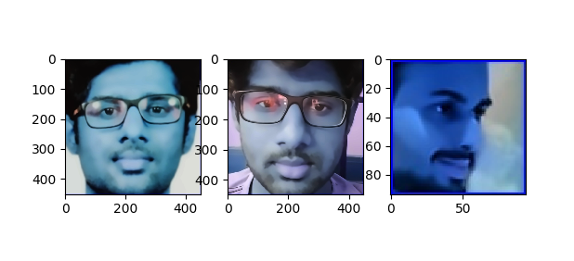
APPENDICES
PROCESS 1 (CROP)

Slide 23
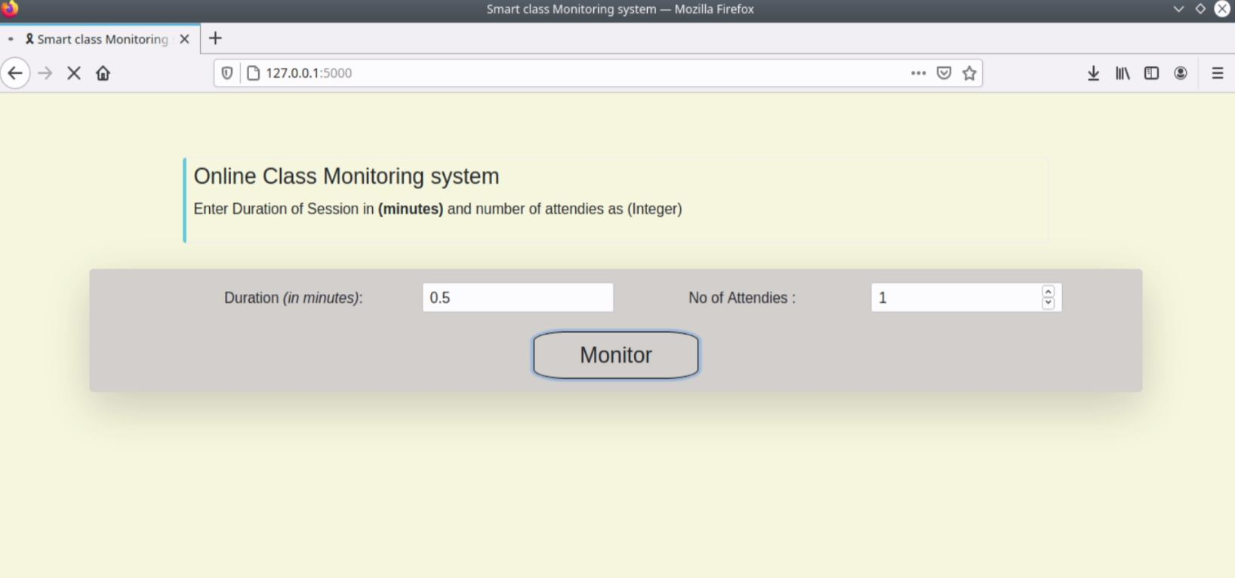
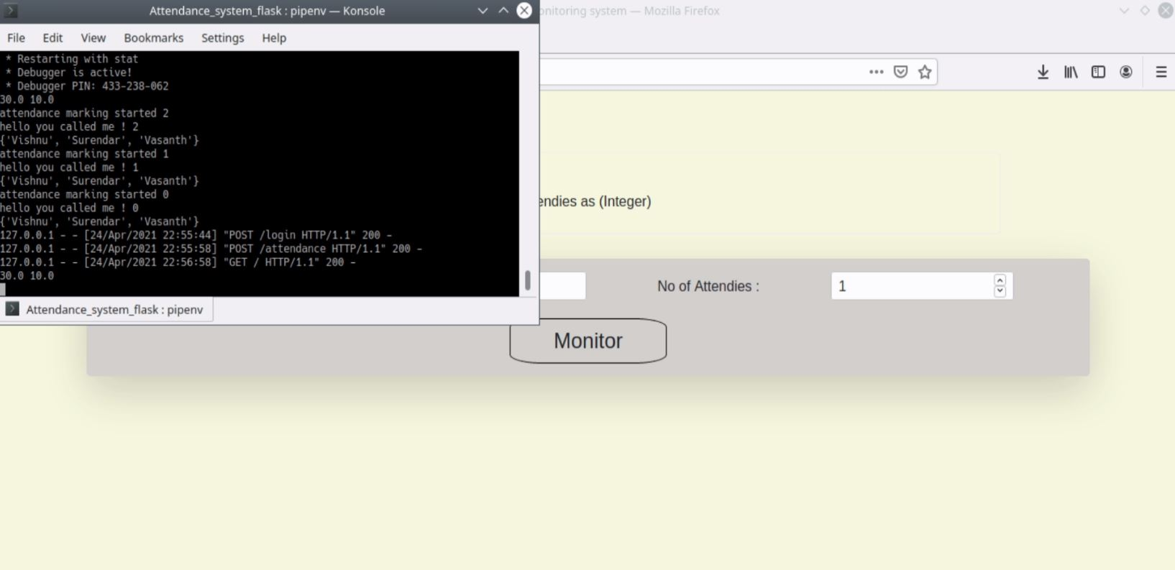

Slide 24
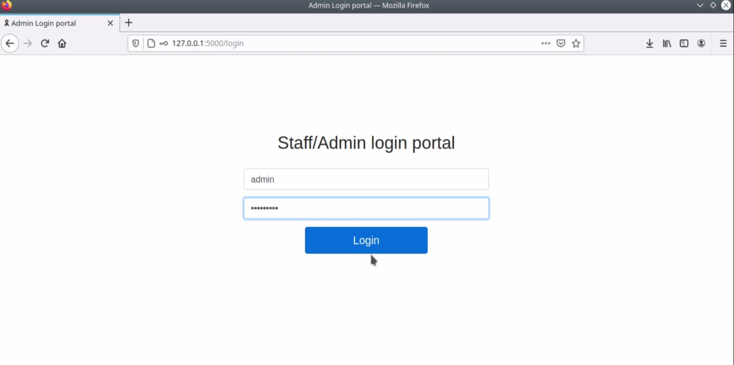
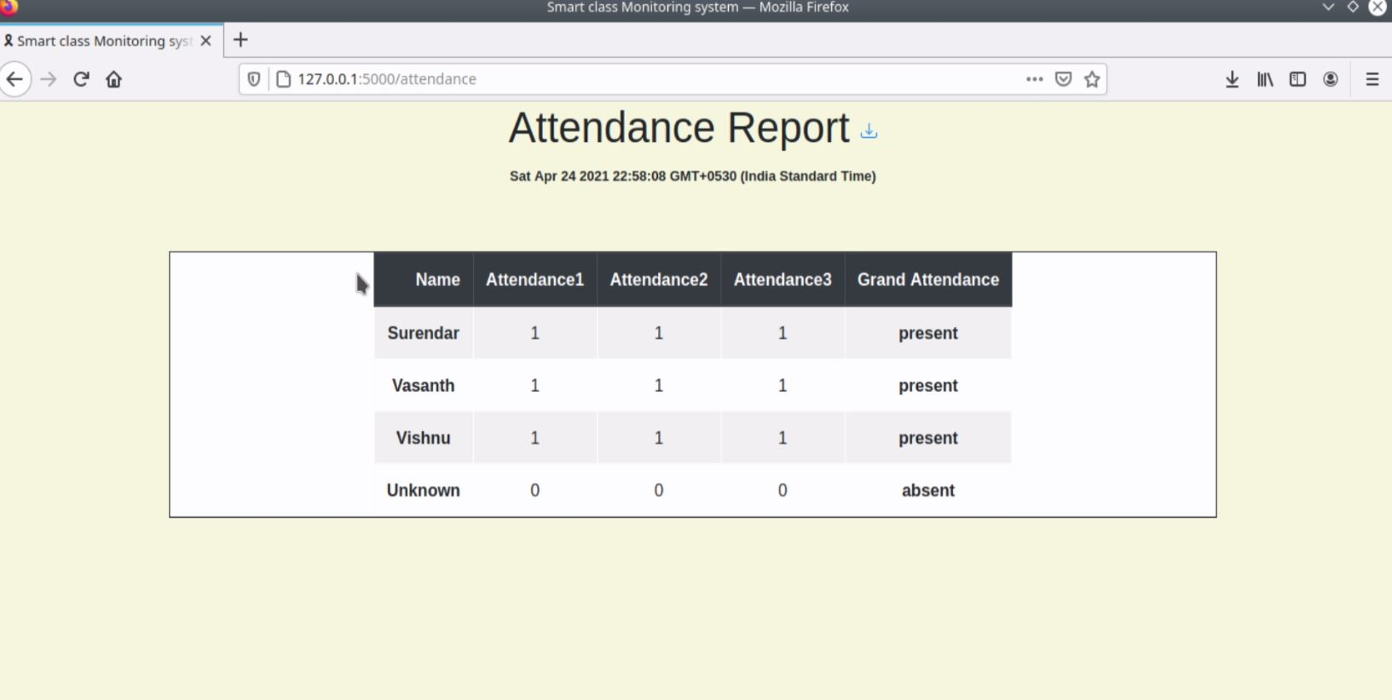

Slide 25
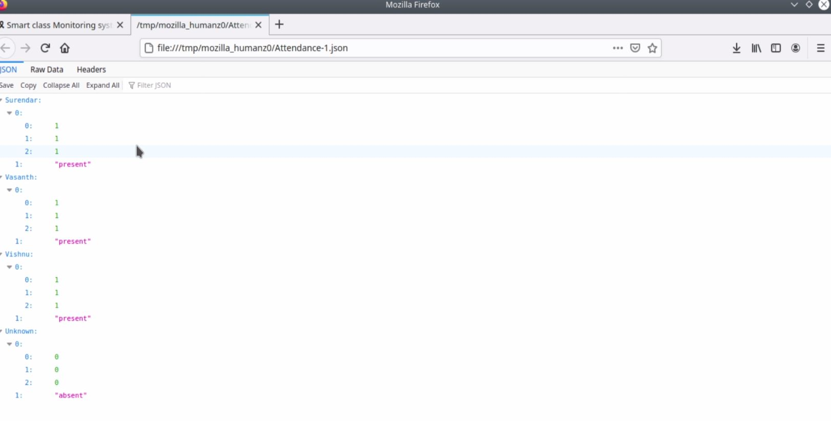
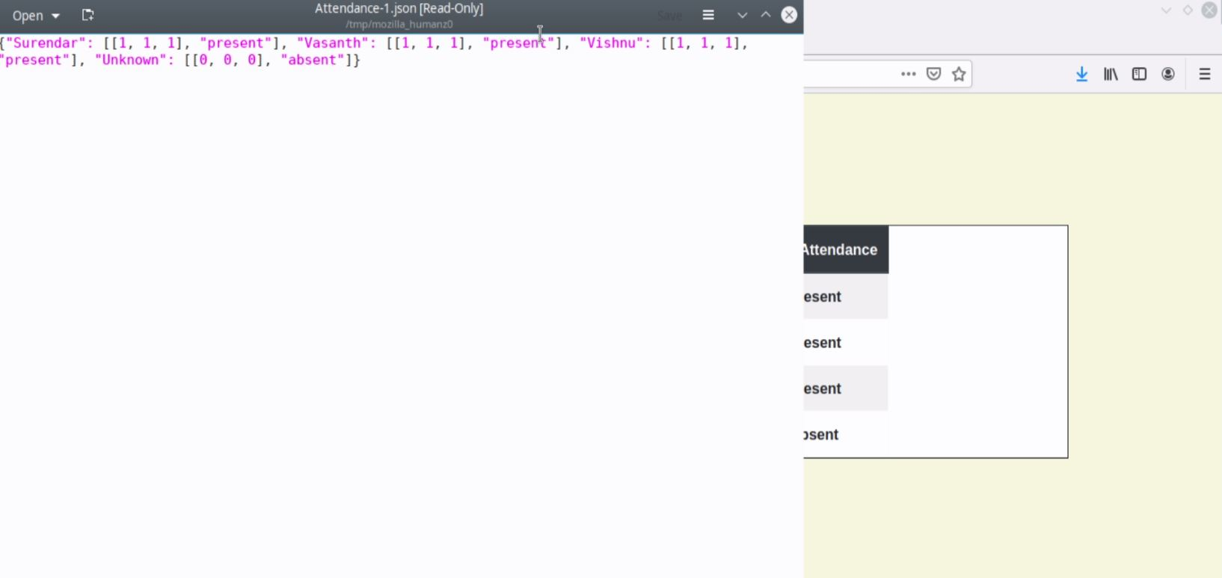

Slide 26
CONCLUSION:
The Main Objective of this project is to reduce the burden by using a Cloud Based attendance system using Facial Recognition.
It takes barely 3 seconds to recognize your face and create an attendance journal in the payroll system, saving precious man-hours.
Automatically scans multiple students, with 99.8% accuracy in face detection.
Saving time will lead to an increase in productivity, resulting in reduction of cost and an increase in revenue

Slide 27
FUTURE SCOPE:
The future work involves building of a complete application or as a plugin for other applications inclusive of much more additional features.
Which makes monitoring and attendance work more simple.

Slide 28
Reference Paper/ URL
[1] https://www.researchgate.net/publication/326261079_Face_detection_
system_for_attendance_of_class’_students
[2] Hapani, Smit, et al. "Automated Attendance System Using Image
Processing." 2018 Fourth International Conference on Computing
Communication Control and Automation (ICCUBEA). IEEE, 2018.
[3] Akbar, Md Sajid, et al. "Face Recognition and RFID Verified
Attendance System." 2018 International Conference on Computing,
Electronics & Communications Engineering (iCCECE). IEEE, 2018.
[4] Okokpujie, Kennedy O., et al. "Design and implementation of a
student attendance system using iris biometric recognition." 2017
International Conference on Computational Science and
Computational Intelligence (CSCI). IEEE, 2017.
[5] Rathod, Hemantkumar, et al. "Automated attendance system using
machine learning approach." 2017 International Conference on
Nascent Technologies in Engineering (ICNTE). IEEE, 2017.
[6] Siswanto, Adrian Rhesa Septian, Anto Satriyo Nugroho, and
Maulahikmah Galinium. "Implementation of face recognition
algorithm for biometrics based time attendance system." 2014
International Conference on ICT For Smart Society (ICISS). IEEE,
2014.

